Slide 1
The Millennium
Part 1 of 2
Dr. Rick Griffith • Jordan Evangelical Theological Seminary • BibleStudyDownloads.org

Slide 2
Why Study General Eschatology?
26
Biblical emphasis
Foundational nature
Spiritual warfare against our hope

Slide 3
Revelation 20:1-3 (NAU)
¹Then I saw an angel coming down from heaven, holding the key of the abyss and a great chain in his hand. ²And he laid hold of the dragon, the serpent of old, who is the devil and Satan, and bound him for a thousand years; ³and he threw him into the abyss, and shut it and sealed it over him, so that he would not deceive the nations any longer, until the thousand years were completed; after these things he must be released for a short time.

Slide 4
Revelation 20:4 (NAU)
⁴Then I saw thrones, and they sat on them, and judgment was given to them. And I saw the souls of those who had been beheaded because of their testimony of Jesus and because of the word of God, and those who had not worshiped the beast or his image, and had not received the mark on their forehead and on their hand; and they came to life and reigned with Christ for a thousand years.

Slide 5
Revelation 20:5-6 (NAU)
⁵The rest of the dead did not come to life until the thousand years were completed. This is the first resurrection. ⁶Blessed and holy is the one who has a part in the first resurrection; over these the second death has no power, but they will be priests of God and of Christ and will reign with Him for a thousand years.

Slide 6
Amillennialism
27
Second Coming
Spiritual reign of Christ
Tribulations
Church Age
Eternal Kingdom
Judgment
Notes:
6

Slide 7
27
Postmillennialism
Second Coming
Golden Age of the Gospel
Tribulations
Church Age
Eternal Kingdom
Judgment
Notes:
7

Slide 8
Premillennialism
27
Second Coming
Second Advent
=
Tribulation
Millennium
Church Age
Eternal Kingdom
7 years
1000 years
Judgment
Judgment
Notes:
8

Slide 9
A Dispensational Timeline
57
Great
White
Throne
(Rev. 20:11-14)
Rapture (1 Thess. 4:13-18)
2nd Advent
(Zech. 14:3-5)
Church Age
Tribulation
(Zech. 14:1-2)
Millennium
(Zech. 14:6-21)
Gog & Magog (Armageddon) (Ezek. 38–39)
Gog and Magog Revisited
(Rev. 20:7-10)
Notes:
9

Slide 10
Is there a future for ethnic believing Israel?
Dispensational
Premillennialism
Amillennialism &
Postmillennialism
Church & Israel distinct
Israel has a future
Church is new Israel
Israel has no future
Covenant
Premillennialism
Notes:
10
Covenant premillennialism seeks to bridge between dispensationalism and the amil/postmil views. Their advocates have largely convinced believers that it was the first view taught I the early church, so they are also called historic premil. But since the covenant premil view is posttrib in its view of the Tribulation, this would imply that the early church was posttrib. In reality, most of the early fathers believed in imminency that leads to a pretrib position, though none of these terms were yet coined.
In any event, both premil views believe in a prophetic future for ethnic Israel, though the covenant view does this inconsistently while seeking also to hold the opposite view that the Church is the “new Israel.”
__________
Common Arabic-260
Common English-230
ES-06-Millennialism Intro-6
ES-07-Premil/Dispensational-10
ES-16-Kingdom&Millennialism-14
NS-06-Romans9-11-slide

Slide 11
Revelation 20:4-6 Diagrammed
NTS 424
^{4b}and they came to life and reigned with Christ for a thousand years.
^{4a}Then I saw thrones, and they sat on them, and judgment was given to them. And I saw the souls of those who had been beheaded because of their testimony of Jesus and because of the word of God, and those who had not worshiped the beast or his image, and had not received the mark on their forehead and on their hand…
1000 years
^{5b}This is the first resurrection. ^{6a}Blessed and holy is the one who has a part in the first resurrection; over these the second death has no power…
^{6b}but they will be priests of God and of Christ and will reign with Him for a thousand years.
^{5a}The rest of the dead did not come to life until the thousand years were completed.

Slide 12
Dispensationalism
28
Definition: Dispensationalism is a theological system of normal interpretation that distinguishes between Israel and the Church to the degree that national Israel still has a future as a believing nation on earth after the return of Christ.

Slide 13
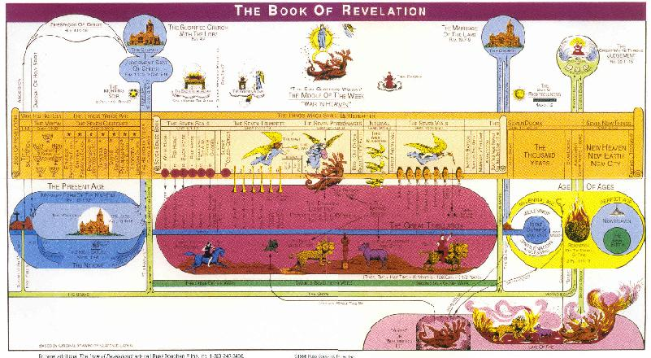
Dispensationalists Like Charts
www.armageddonbooks.com

Slide 14
Dispensationalists Like Charts
www.armageddonbooks.com

Slide 15
Dispensationalists Like Charts
www.armageddonbooks.com

Slide 16
Dispensationalists Like Charts
www.armageddonbooks.com

Slide 17
Dispensationalists Like Charts
www.armageddonbooks.com

Slide 18
What's the Difference?
29
 | Dispensational | Non-Dispensational
Israel & the Church | Separate entities Israel ≠ Church | Same people of God Israel = Church (the "New Israel")
Literal Interpretation | Consistently employed | Spiritualizing acceptable
Unifying Theme of Bible | Glory of God or Kingdom of God | Redemption of man or Kingdom of God

Slide 19
What's the Difference?
29
 | Dispensational | Non-Dispensational
Millennial View | Always premil | Pre-, Post-, or Amil
Tribulational View | Pretrib | Mid- or Posttrib
Recognizes Differing Economies | Yes–often 7 dispensations | Yes & No–Covenant of Grace but no sacrifices

Slide 20
What's the Difference?
29
 | Dispensational | Non-Dispensational
Biblical Covenants | Unconditional | Conditional or fulfilled
Future for Israel? | Yes | No (though covenant/ historic premil says yes)
Is the Church foreseen in the OT? | Generally No | Yes

Slide 21
What's the Difference?
29
 | Dispensational | Non-Dispensational
Distinguishes law & grace | More sharply | Not so sharp
Theological stance | Almost always conservative (few premil liberals!) | Conservative or liberal
Number of Adherents | Many–especially at lay level and at Bible colleges | Growing–especially at seminary level and Catholic Church

Slide 22
A Literal Kingdom for David's Line
22-23
Ordinary language for "kingdom" is used
Prophets interpreted the kingdom literally
Israel interpreted the kingdom literally
586 BC kingdom overthrown is the same kind
The Davidic Covenant relates only to Israel
David saw the covenant applying only to Israel
Portions have been fulfilled literally
David's throne is not related to Christ's present session in heaven
John, Jesus, the 12, and the 70 all offered Israel a literal kingdom (Matt. 3:11; 4:17; 10:7; Luke 10:1, 9)

Slide 23
Black

Slide 24
Future (Eschatology) at BibleStudyDownloads.org
Get this presentation for free!
Notes:
Future (fu)
Eschatology

